Slide 1
Tools Installation in Ubuntu
SHAKTI Group | CSE Dept | PS-CDISHA - RISE LAB
IIT - Madras

Slide 2
Preview of the Session
Hardware Dependencies
2. Vivado Installation
3. Bluespec Compiler Installation
4. RISCV-GNU-Toolchain Installation
5. Spike Installation
6. Verilator Installation
7. GTKwave and GTKterm

Slide 3
Introduction
A set of Hardware and Software tools are required for Shakti SOC development.
*It is recommended to use a system with Ubuntu 22.04.LTS.
HARDWARE Dependencies:
Vivado IDE
Vivado Cable driver.
Copying Board Files
Bluespec Compiler
GTKWave
Installation dependencies
SOFTWARE Dependencies:
RISC-V GNU toolchain.
Spike
Verilator.
Gtkterm

Slide 4
Common Dependencies
The following installation dependencies are required by both Hardware and Software Shakti flow.
Open a terminal and Start Installing!
Command:
→ sudo apt-get install autoconf automake autotools-dev curl make libmpc-dev libmpfr-dev libgmp-dev bc gawk build-essential bison flex texinfo gperf libtool patchutils zlib1g-dev pkg-config

Slide 5
Vivado Installation
A set of Vivado dependencies which are used for connecting FPGA boards to Vivado and programming the FPGA boards needs to be installed before starting vivado installation.
Command:
→ sudo apt-get install libusb-1.0-0-dev libusb-0.1-4 libftdi1 libftdi1-2 libncurses5
After installing the above dependencies, proceed on to download the Vivado software from the Link provided.
https://www.xilinx.com/member/forms/download/xef-vivado.html?filename=Xilinx_Vivado_SDK_2018.3_1207_2324.tar.gz
Note: *
A login is required to download the tar file in the AMD website.
Higher versions also can be installed.

Slide 6
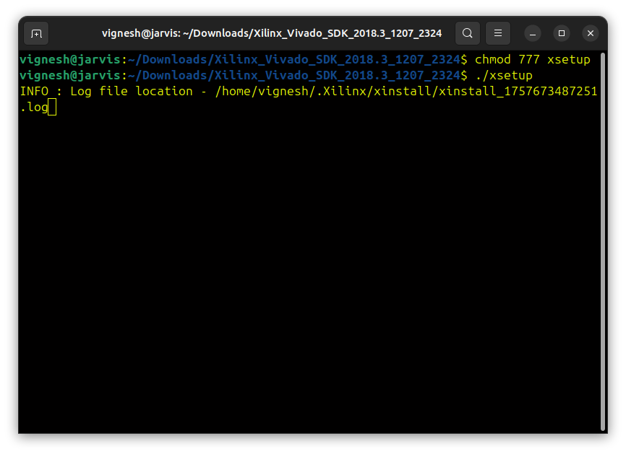
Vivado Installation
After downloading, go to the file location and untar the file “<filename>.tar.xz”
→ tar xf Xilinx_Vivado_SDK_2018.3_1207_2324.tar.gz
Go inside the Untarred folder and update file permission (executable) of the file “xsetup” by using the command
→ chmod 777 xsetup
Run the code “./xsetup” (./xsetup) in the terminal”

Slide 7
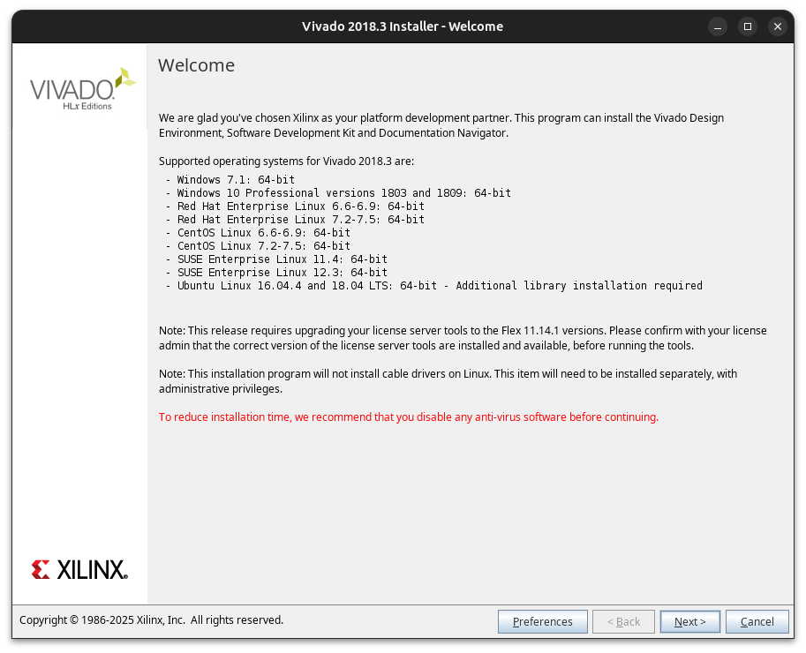
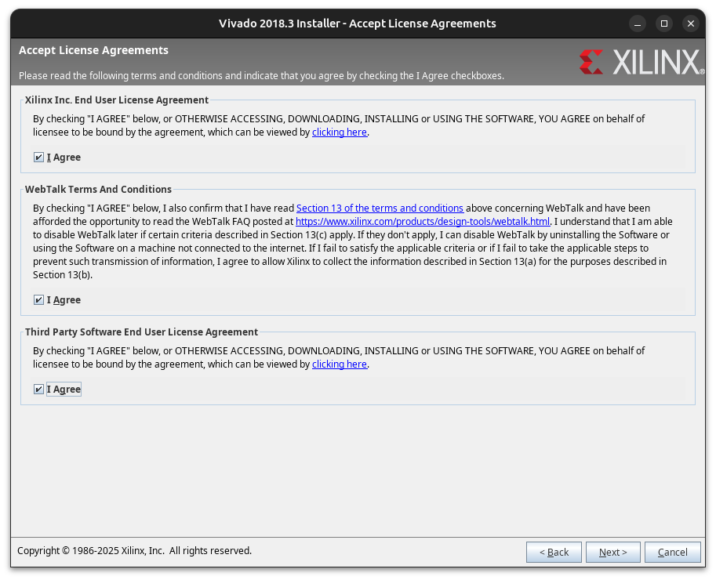
Vivado Installation flow

Slide 8
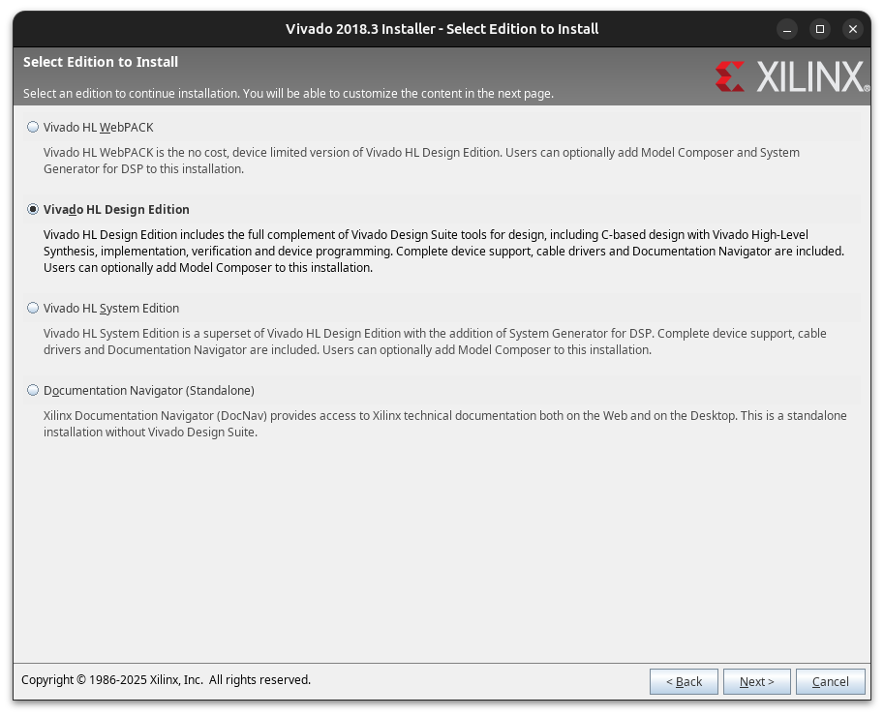
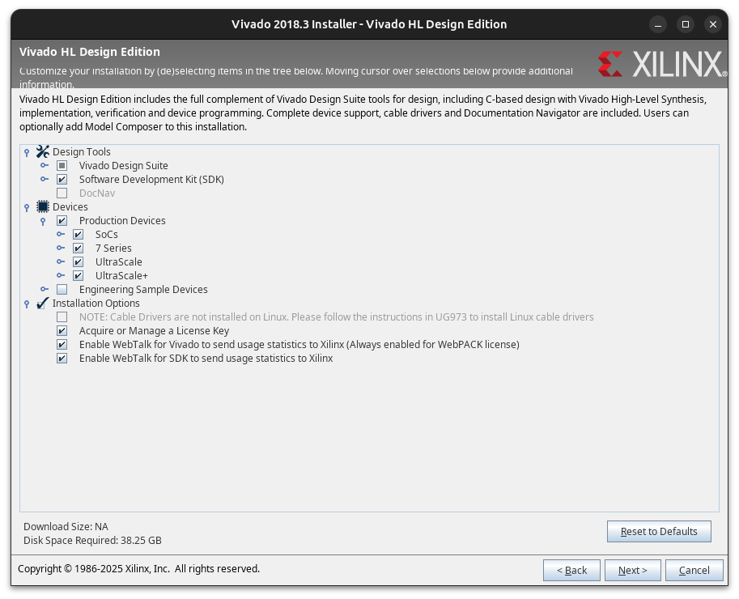
Vivado Installation flow

Slide 9
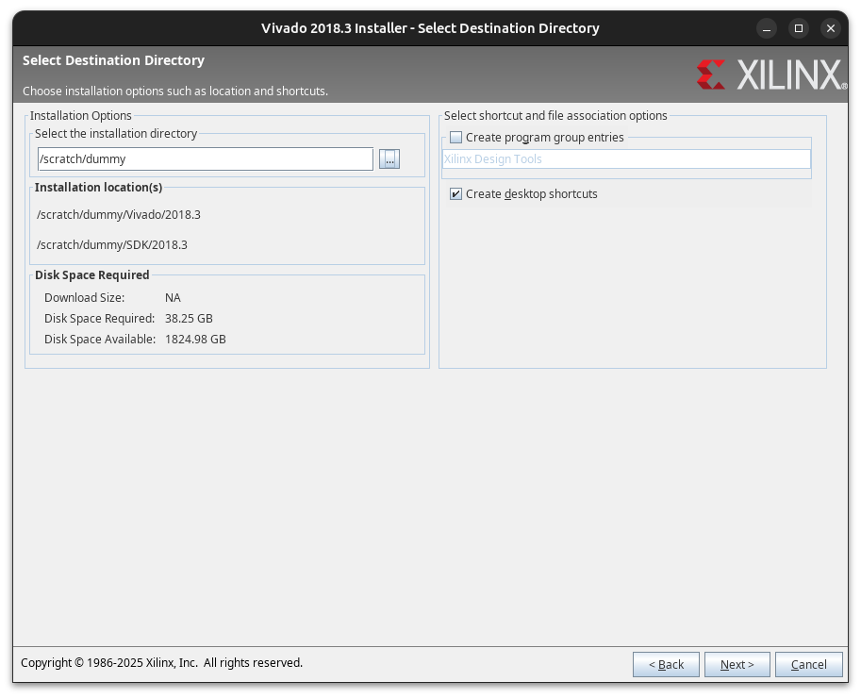
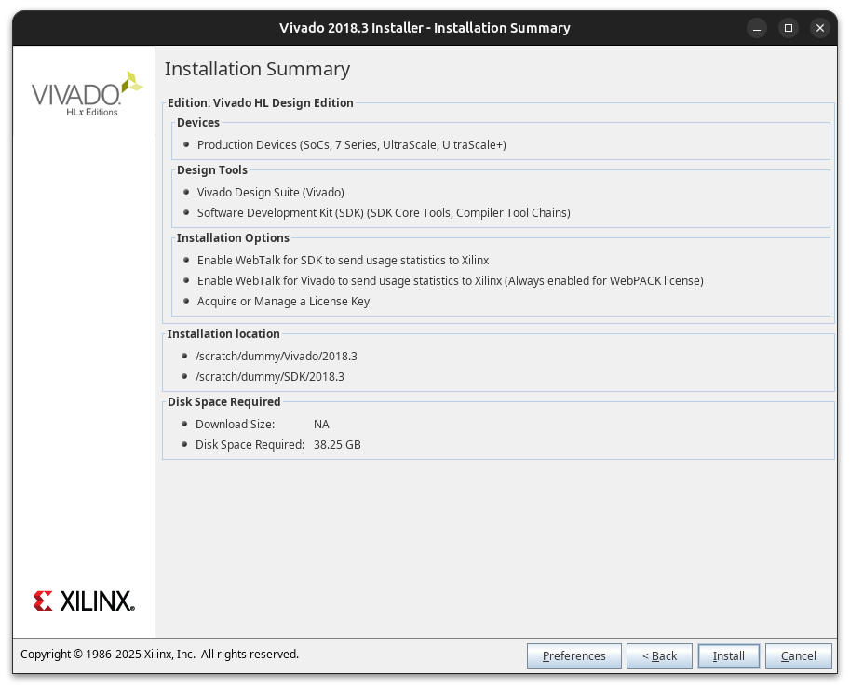
Vivado Installation flow

Slide 10
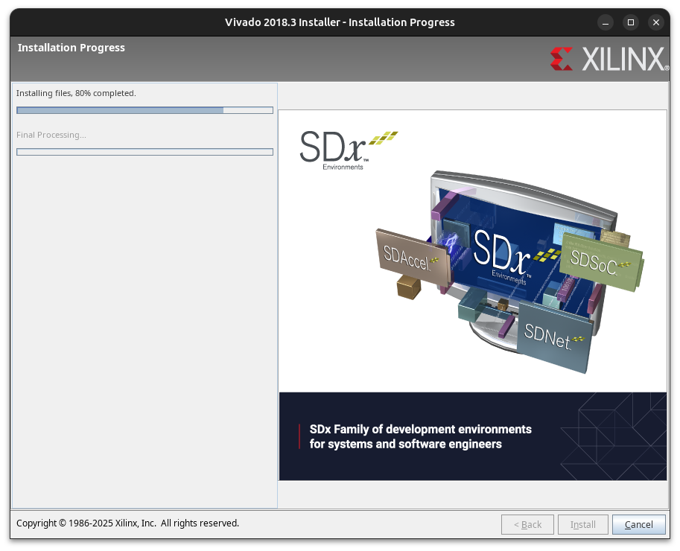
Vivado Installation flow

Slide 11
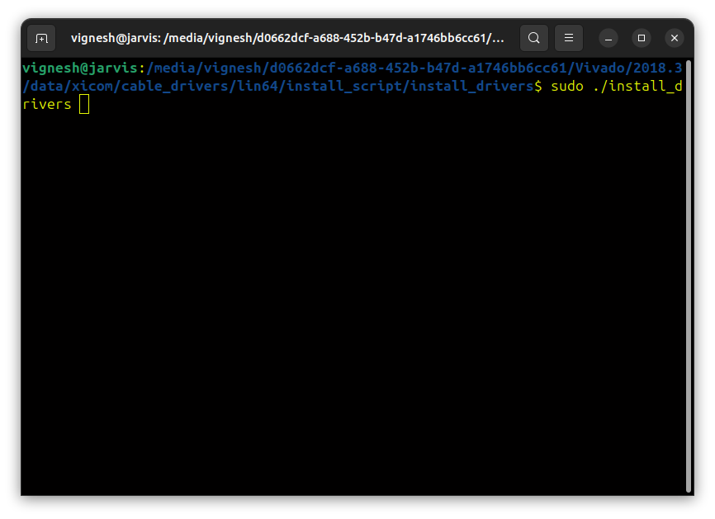
Post Installation
After installation, do the following.
1.Go to the folder “[installed folder]/vivado/Vivado/2018.3/data/xicom/cable_drivers/lin64/install_script/install_drivers/”
2.run “sudo ./install_drivers”
Figure 9: Drivers Installation command
These drivers are not available pre-installed in the Vivado ,so it is required to install them before connecting the board.
*These drivers are not available pre-installed in the Vivado, so it needs to be installed before connecting the board.

Slide 12
Adding board files
Board files can be added on cloning the board files from digilent github page.
a. Clone the repo.
→ git clone https://github.com/Digilent/vivado-boards.git
b. Go to the folder ./Digilent/vivado-boards/tree/master/new/board_files and copy them.
c. Paste the files to [vivado installed path]/Vivado/2018.3/data/boards/board_files.

Slide 13
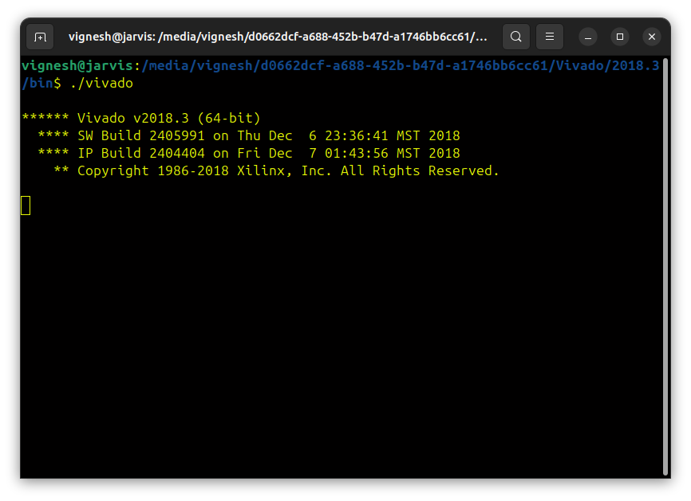
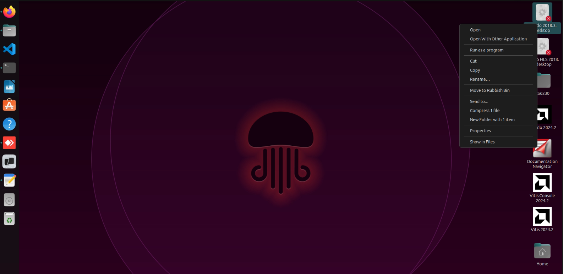
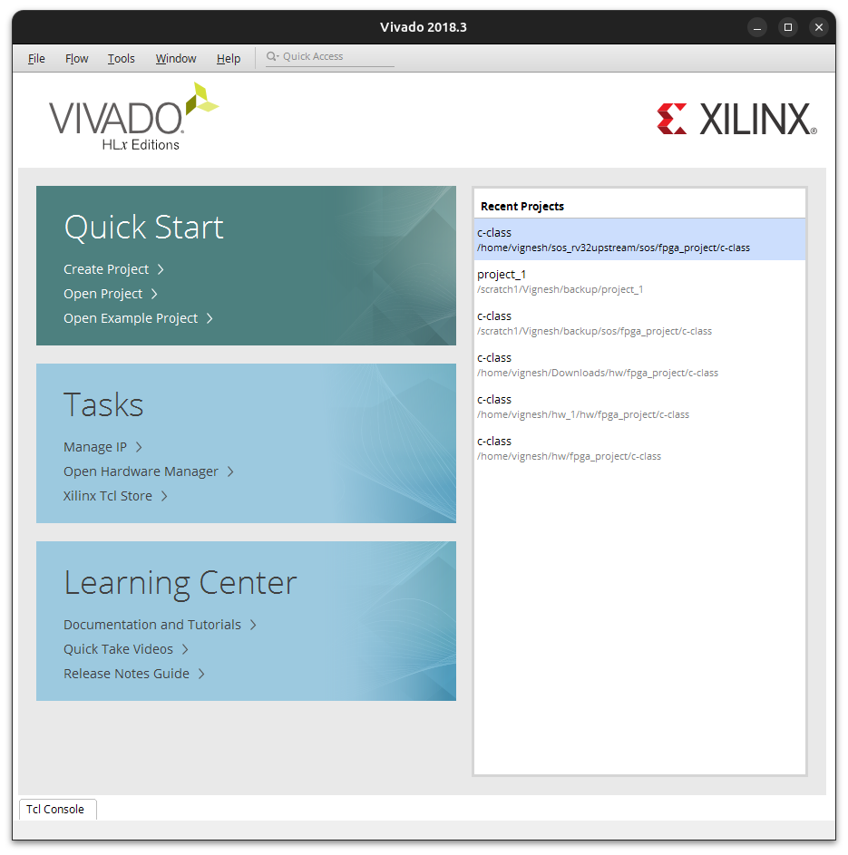
Invoking Vivado application
Vivado application can be invoked in two following ways.
1.Through icon in home:
1. Go to the Desktop and find the vivado icon
2. Right click and select “Allow Launch”
3.Double clicking the icon should open Vivado
2.Through Terminal
Go to following path “/path/install/vivado/Vivado/2018.3/”
Right click and open new terminal
Run the following command ./vivado , this should open vivado
Note: The executable path can be added to “.bashrc”.

Slide 14
Bluespec Compiler Installation
Installation of Bluespec compiler is necessary as almost everything in and around Shakti is on Bluespec.
Install these specific dependencies and clone the repository:
→ sudo apt-get install ghc libghc-regex-compat-dev libghc-syb-dev libghc-old-time-dev libghc-split-dev tcl-dev
Clone the repo “ git clone --recursive https://github.com/B-Lang-org/bsc”
Go into bsc , checkout the git to 2025.01.1 branch and install from source:
→ cd bsc
→ git checkout 2025.01.1
→sudo make install-src

Slide 15
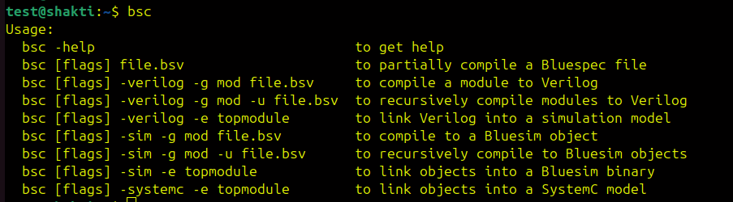
Bluespec Compiler Installation
Add the bluespec to the PATH in Linux by adding it to .bashrc
→ echo 'export PATH=/home/test/bsc/inst/bin:$PATH' >> ~/.bashrc
Bluespec compiler can be invoked easily with a small command:
→bsc

Slide 16
RISC-V GNU Toolchain Installation
Install these specific dependencies and clone the repository:
→ sudo apt-get install python3 python3-pip libexpat-dev ninja-build git cmake libglib2.0-dev libslirp-dev
→ git clone https://github.com/riscv/riscv-gnu-toolchain
After cloning go into the folder , update the submodule, change version of gcc to 13.2 ,configure and make.These commands will configure ,make and install the toolchain. This will contain both 32-bit and 64-bit toolchain
→ cd riscv-gnu-toolchain
→ git submodule update --init --recursive
→ sudo rm -rf gcc
→ git clone https://gcc.gnu.org/git/gcc.git
→ cd gcc
→ git checkout releases/gcc-13.2.0
→ cd ..
→ mkdir build_rv
→ ./configure --prefix=/path/to/toolchain/build_rv --enable-multilib
→ sudo make -j $(nproc)

Slide 17
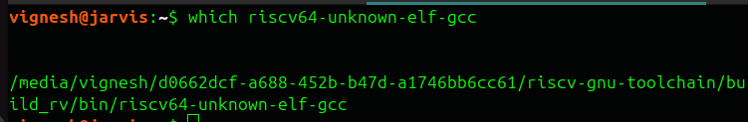
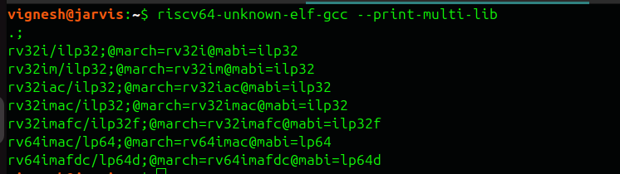
RISC-V GNU Toolchain Installation
Add the path to .bashrc
→ echo 'export PATH=’[Path to risc-v toolchain]/riscv-gnu-toolchain/build_rv/bin:$PATH' >> ~/.bashrc
To verify try these commands:
→ which riscv64-unknown-elf-gcc
→ riscv64-unknown-elf-gcc --print-multi-lib

Slide 18
Spike Installation
Install these specific dependencies and clone the git from this repository :
→ sudo apt-get install device-tree-compiler libboost-regex-dev libboost-system-dev
→ git clone https://github.com/riscv-software-src/riscv-isa-sim.git
Go inside the cloned directory and checkout to the specified branch:
→ cd riscv-isa-sim
→ git checkout d39cbb3ad27b2de882260c0a22f11a59efebb151

Slide 19
Spike Installation
Create a build directory , configure it and make:
→ mkdir build
→ cd build
→ export RISCV=/path/to/install/spike
→ ./configure --prefix=$RISCV
→ sudo make -j $(nproc)
→ sudo make install

Slide 20
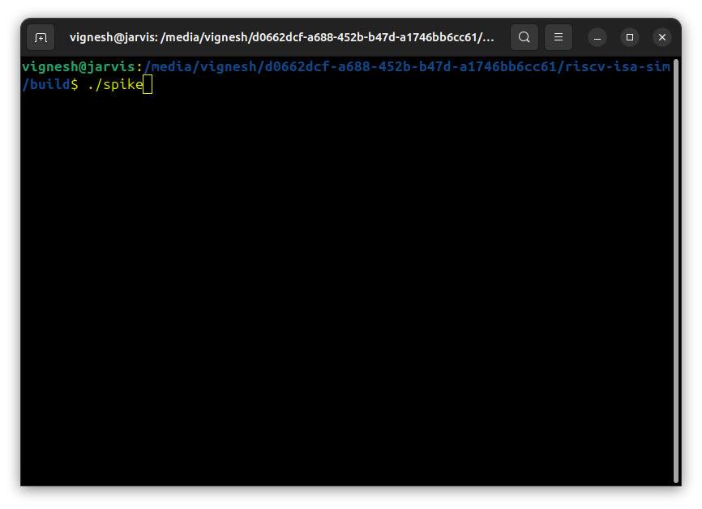
Spike Installation
After Installation, Spike can be invoked with this command:
→ ./spike

Slide 21
Verilator Installation
Install the specific dependencies and clone the git from the specified directory:
→ sudo apt-get install perl g++ ccache libgoogle-perftools-dev numactl perl-doc libfl2 libfl-dev zlib1g help2man
→ git clone https://github.com/verilator/verilator
Go into the cloned directory and checkout to the specified branch:
→ cd verilator
→ git checkout v5.024

Slide 22
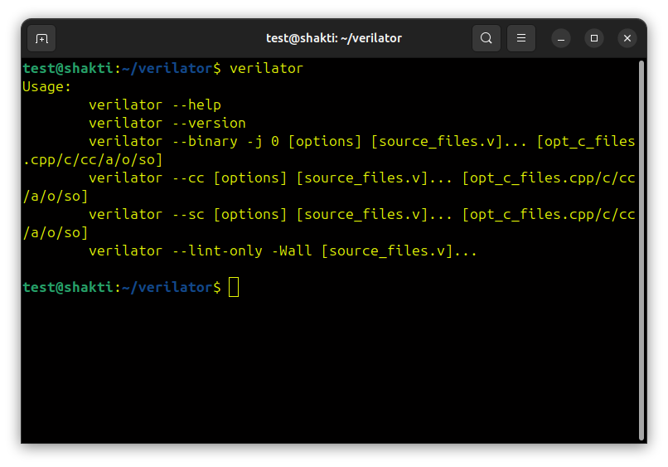
Verilator Installation
Install Verilator through these commands:
→ unset VERILATOR_ROOT
→ autoconf
→ ./configure
→ make -j `nproc`
→ sudo make install
After Installation, we can check if verilator is there by giving,
→ verilator

Slide 23
GTKterm and GTKwave
GTKwave → simulation software for checking the waveforms for the specific code.
GTKterm → emulator used for getting outputs from serial ports.
Installation of GTKwave and GTKterm is pretty simple, and are done through these commands:
→ sudo apt install gtkterm -y
→sudo apt install gtkwave -y
GTKterm and GTKwave can be used very easily through these commands:
→ sudo gtkterm
→ sudo gtkwave

Slide 24
Thank you

